Slide 1
Tutorial 12 - Week 13
We’ll be starting at the 10 minute mark

Slide 2
Agenda
Lecture review
Introduction to Pandas
Series and Dataframes
Attributes and Methods
Indexing, .loc and .iloc-operators
Built-in Pandas methods
Practice questions

Slide 3
Review of Lecture
Introduction to Pandas

Slide 4
Review: File I/O – Working with CSV Files using the CSV reader Class of the CSV module
import csv
with open('grades.csv', 'r') as csvfile:
grades_reader = csv.reader(csvfile)
row_num = 1
for row in grades_reader:
print('Row #', row_num, ':', row)
row_num += 1
Open the csv file and create a csv reader object
Iterate through each row in the csv reader object
Display the content of the file to the standard output
Row # 1 : ['Name', 'Test1', 'Test2', 'Final']
Row # 2 : ['John', '100', '50', '29']
Row # 3 : ['Mark', '76', '32', '33']
Row # 4 : ['Sam', '25', '75', '95']
Output

Slide 5
Review: File I/O – Working with CSV Files using the CSV reader Class of the CSV module
What if we wanted to print out just the first two (header + first data entry) rows?
import csv
with open('grades.csv', 'r') as csvfile:
grades_reader = csv.reader(csvfile)
row_num = 1
for row in grades_reader:
if row_num == 1 or row_num == 2:
print('Row #', row_num, ':', row)
row_num += 1
Notice that csv module does not have the context of the first row as being the column labels
As well, this is quite a manual approach, requiring both a for loop and an if statement to access rows.
Output
Row # 1 : ['Name', 'Test1', 'Test2', 'Final']
Row # 2 : ['John', '100', '50', '29']

Slide 6
What is pandas?
An open-source library to help create easy-to-use data structures and data analysis tools in Python
Does not come pre-installed unlike other modules, need to install like so:
!pip install pandas
Generally, imported as follows:
import pandas as pd
Pandas provides two classes for handling data (more on this later):
Series: one-dimensional labelled array holding any type of data
DataFrames: two-dimensional data-structure (rows and columns)

Slide 7
Review of Lecture
DataFrames

Slide 8
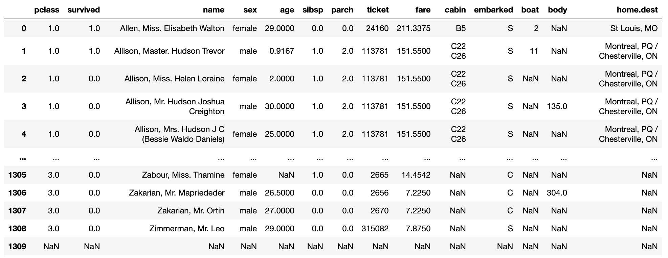
Introduction to the DataFrame
columns
Index (does not have to be row number!)
data

Slide 9
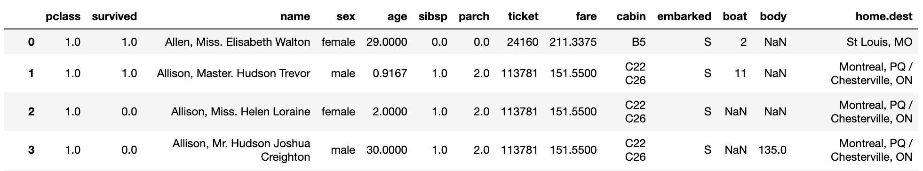
How to create a DataFrame - 3 ways
From a CSV
import pandas as pd
titanic_df = pd.read_csv('titanic.csv')
titantic_df # to preview results

Slide 10
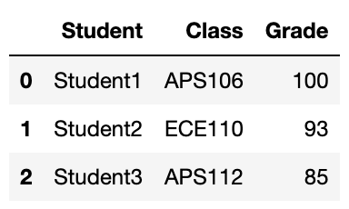
How to create a DataFrame - 3 ways
2. Using a list and column names
import pandas as pd
columns = ['Student', 'Class', 'Grade']
data = [
['Student1','APS106',100],
['Student2','ECE110', 93],
['Student3','APS112',85]
] # notice this is a nested list structure for data
student_df = pd.DataFrame(columns=columns, data=data)
student_df # to preview results

Slide 11
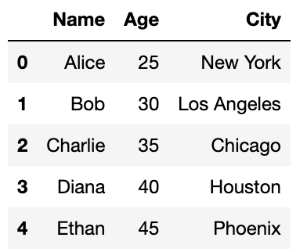
How to create a DataFrame - 3 ways
3. From a dictionary
import pandas as pd
locations_df = pd.DataFrame(
{"Name": ["Alice", "Bob", "Charlie", "Diana", "Ethan"],
"Age": [25, 30, 35, 40, 45],
"City": ["New York", "Los Angeles", "Chicago", "Houston",
"Phoenix"]})
locations_df # to preview results

Slide 12
Accessing DataFrame attributes (components)
Accessing the index:
titanic_df.index
>>RangeIndex(start=0, stop=1310, step=1)
Accessing the column names:
titanic_df.columns
>>Index(['pclass', 'survived', 'name', 'sex', 'age', 'sibsp', 'parch', 'ticket',
'fare', 'cabin', 'embarked', 'boat', 'body', 'home.dest'],
dtype='object')
Accessing the shape (remember, it’s always row/column syntax!):
titanic_df.shape
>>(1310, 14)

Slide 13
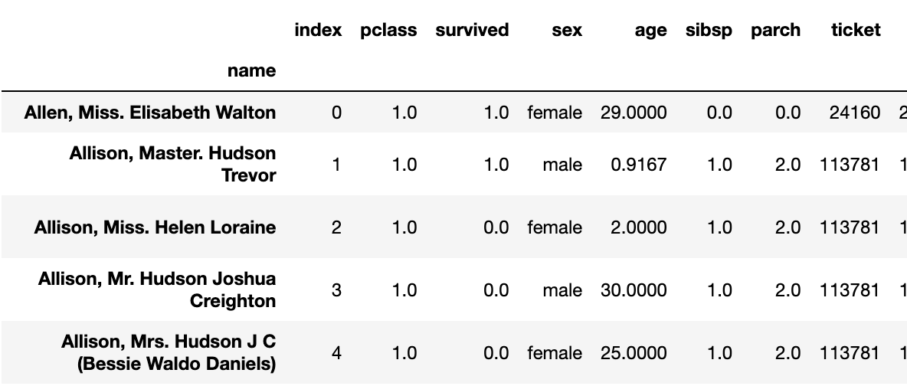
DataFrame methods
Setting a new index from a column:
titanic_df = titanic_df.reset_index()
titanic_df = titanic_df.set_index('name')
Preview a DataFrame (head/tail):
titanic_df.head() # first 5 rows
titanic_df.head(10) # modify num rows previewed
titanic_df.tail(10) # last 5 rows
Save a DataFrame into a csv file:
titanic_df.to_csv('titanic_data.csv')

Slide 14
Review of Lecture
Series

Slide 15
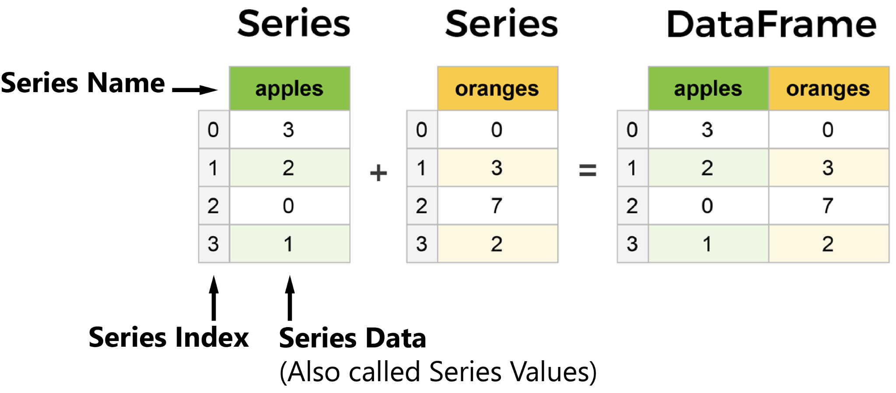
Series and DataFrame Objects
Series are always one-dimensional, and can be thought of as a column in DataFrame which is a tabular (row/column structure):

Slide 16
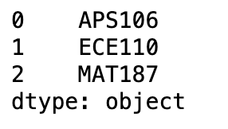
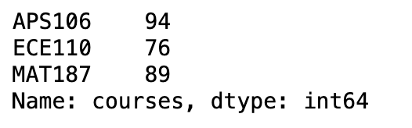
How to create a Series
We can pass in a list, like so:
courses = pd.Series(['APS106', 'ECE110', 'MAT187'])
courses # to preview results
We alternatively can specify attributes:
courses = pd.Series(
index = ['APS106', 'ECE110', 'MAT187'],
data = [94, 76, 89],
name = 'courses')

Slide 17
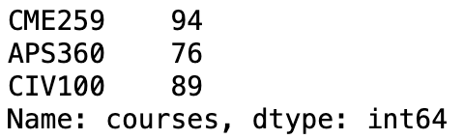
Accessing Series attributes
Same process as for DataFrames:
print(courses.name)
print(courses.shape)
print(courses.index)
print(courses.values) # notice not called data like in DataFrames
>> courses
>> (3,)
>> Index(['APS106', 'ECE110', 'MAT187'], dtype='object')
>> [94 76 89]
And similar to DataFrames, we can overwrite values, the index with these attributes.
courses.index = ['CME259', 'APS360', 'CIV100']

Slide 18
Review of Lecture
Indexing with .loc and .iloc

Slide 19
loc vs. iloc
The loc method is primarily based for label-based indexing
In contrast, the iloc method is used for integer-based indexing
Main difference occurs in how we access the columns between these two methods
General syntax for slicing and indexing:
df.loc[[row], [col]] #indexing, same for iloc
df.loc[[row1:row2], [col1:col2]] #slicing, same for iloc

Slide 20
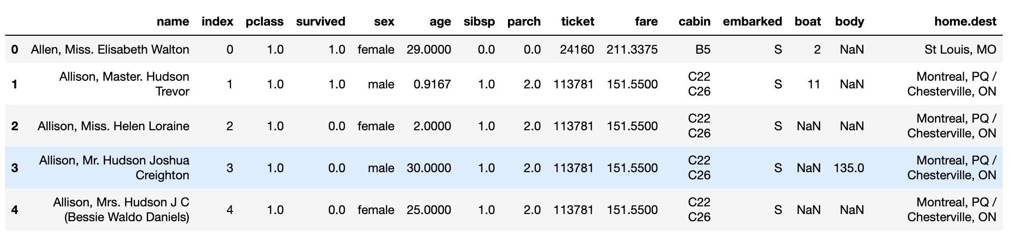
Example DataFrame: titanic_df
Numeric index
Columns of interest:
name, position 0
age, position 5
survived, position 3

Slide 21
loc: label-based extraction
Getting a single row (row 1), across all columns: titanic_df.loc[0,:]
Just getting a single column (name) across all rows:
titanic_df.loc[:,'name'] #returns a series
titanic_df.loc[:,['name']] #returns a dataframe
Combining these (rows 1-5 (includes row 5), name/age/survived):
titanic_df.loc[1:5,['name','age', 'survived']]
We can combine with steps, etc.:
titanic_df.loc[::2,::2] #every second row and col

Slide 22
iloc: label-based extraction
Getting a single row (row 1), across all columns (same): titanic_df.iloc[0,:]
DIFFERENT: getting a single column (name, pos 0) across all rows:
titanic_df.iloc[:,0]
Combining these (rows 1-5 (row 5 not included), name/age/survived):
titanic_df.iloc[1:5,[0, 5, 3]]
We can combine with steps, etc.:
titanic_df.iloc[::2,::2] #every second row and col

Slide 23


Given the Pandas Series temps, which represents the monthly average temperatures, how would you access the temperature for the month of June?
ⓘ
Click Present with Slido or install our Chrome extension to activate this poll while presenting.
Notes:
📣 This is Slido interaction slide, please don't delete it. ✅ Click on 'Present with Slido' and the poll will launch automatically when you get to this slide.

Slide 24
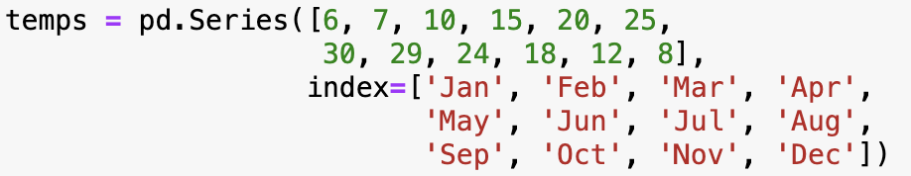
Review Practice Problem
Given the Pandas Series temps, which represents the monthly average temperatures, how would you access the temperature for the month of June?
temps[‘Jun’]
temps.iloc[5]
temps.loc[‘Jun’]
All of the above

Slide 25
Looping using indexing
We can loop over the rows using index-labels with loc:
for row_label in titanic_df.index:
name = titanic_df.loc[row_label, 'name']
print(name.split(',')[0]) # gets the last-name
Equivalent using an integer series for iloc and a range from shape:
for row_label in range(titanic_df.shape[0]):
name = titanic_df.iloc[row_label, 0]
print(name.split(',')[0])

Slide 26
Looping using indexing
We can loop over the items directly in a series:
for item in my_series:
print(item)
Or loop through the indices:
for index in my_series.index:
print(my_series.loc[index])

Slide 27
Review of Lecture
Conditional Selection, Modifying Columns

Slide 28
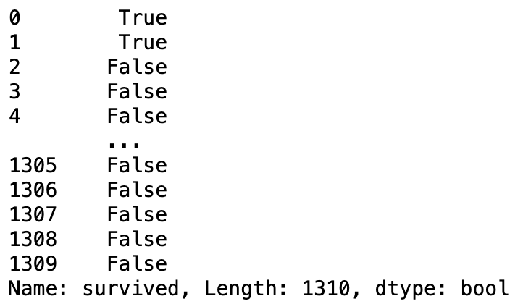
Conditional Selection
We can create a boolean series from checking values across rows or columns like so:
survived = titanic_df.loc[:,'survived'] == 1
print(survived)
“Across all rows, check in ‘survived’ column for value 1 “

Slide 29
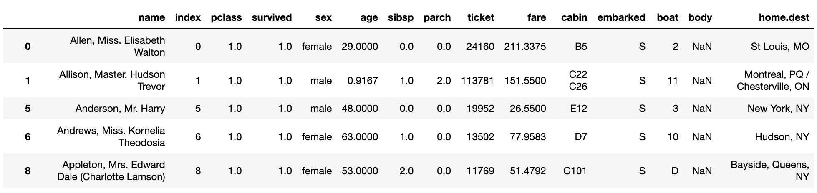
Conditional Selection Cont.
This boolean series can be used as a mask to return a filtered DataFrame:
survived = titanic_df.loc[:,'survived'] == 1 #return bool series
titanic_df.loc[survived, :] #return True rows, across all col

Slide 30
Conditional Selection Cont.
We can also specify multiple conditions!
and &
or |
not ~ (tilda)
survived = titanic_df.loc[:,'survived'] == 1
female = titanic_df.loc[:,'sex'] == 'female'
titanic_df.loc[survived & female, :]

Slide 31
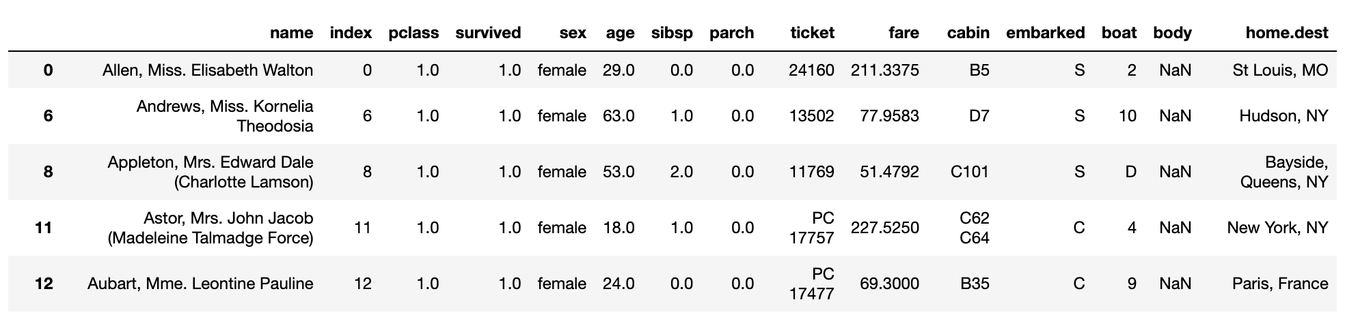
Conditional Selection Cont.
Or the same in one line:
titanic_df.loc[(titanic_df.loc[:,'survived'] == 1) &(titanic_df.loc[:,'sex'] == 'female'), :]

Slide 32

How would you filter this DataFrame to return rows where the name is Charlie or the city is Houston?
ⓘ
Click Present with Slido or install our Chrome extension to activate this poll while presenting.
Notes:
📣 This is Slido interaction slide, please don't delete it. ✅ Click on 'Present with Slido' and the poll will launch automatically when you get to this slide.

Slide 33
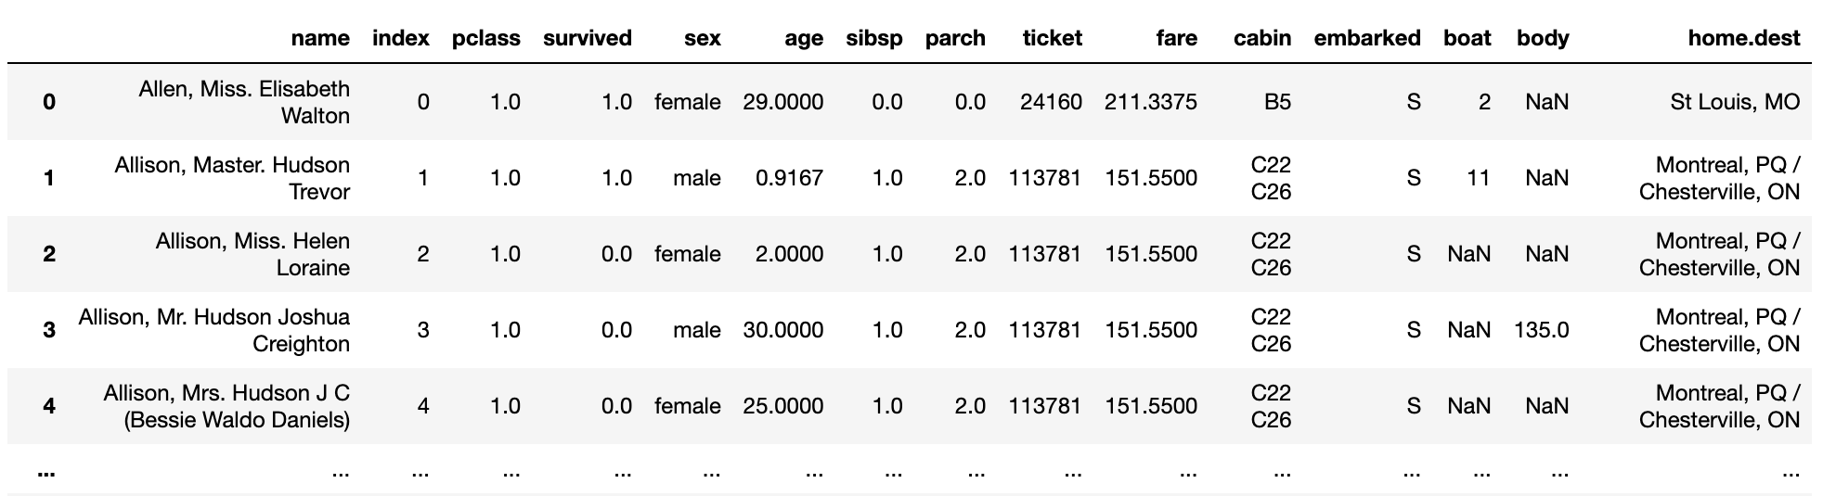
Membership
Can use isin() when have a list to filter against:
locations = ['St Louis, MO', 'Montreal, PQ / Chesterville, ON', 'New York NY']
home = titanic_df.loc[:,'home.dest'].isin(locations)
titanic_df.loc[home, :]

Slide 34
Using df, you want to select the 'Author' and 'Price' columns for the books 'Beloved' and 'Brief History'. Which of the following options is NOT an equivalent way to perform this operation?
ⓘ
Click Present with Slido or install our Chrome extension to activate this poll while presenting.
Notes:
📣 This is Slido interaction slide, please don't delete it. ✅ Click on 'Present with Slido' and the poll will launch automatically when you get to this slide.

Slide 35
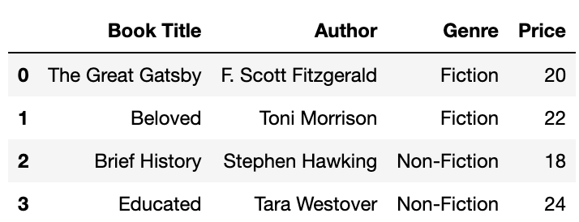
Review Practice Problem
Using df, you want to select the 'Author' and 'Price' columns for the books 'Beloved' and 'Brief History'. Which of the following options is not an equivalent way to perform this operation?
df.loc[1:2, ['Author', 'Price']]
df.iloc[1:3, [1, 3]]
df.loc[df['Book Title'].isin(['Beloved', 'Brief History']), ['Author', 'Price']]
df.loc[1:2, 'Author':'Price']

Slide 36
Adding, Removing, Modifying Columns
Adding a column
titanic_df.loc[:,'test'] = 0 #assign 0 to all rows
Modifying a column
titanic_df.loc[:,'fare'] = titanic_df.loc[:,'fare'] - 20
Rename
titanic_df = titanic_df.rename(columns={'test':'temp-column'})
Delete a column
titanic_df = titanic_df.drop(['temp_column'], axis='Columns')

Slide 37
Utility Methods
Operation | DataFrame | Series
max() | titanic_df.max(axis=0) # col titanic_df.max(axis=1) # row, numeric* | titanic_df.loc[:, “age”].max()
min() | titanic_df.min(axis=0) # col titanic_df.min(axis=1) # row | titanic_df.loc[:, “age”].min()
mean() | titanic_df.loc[:,['age','fare']].mean() | titanic_df.loc[:, “age”].mean()
unique() | NA | titanic_df.loc[:, “age”].unique()
sort_values() | titanic_df.sort_values(by=[‘age’,’fare’],ascending=[True,False]) | titanic_df.loc[:, “age”].sort_values()
value_counts() | NA | titanic_df.loc[:, “age”].value_counts()
astype() | titanic_df.astype({“age”:str, “fare”:str}) | titanic_df.loc[:, “age”].astype(str)

Slide 38
String Methods
Operation | Series (notice we call str first!)
upper() | titanic_df.loc[:, “name”].str.upper()
lower() | titanic_df.loc[:, “name”].str.lower()
len() | titanic_df.loc[:, “name”].str.len() # returns length for each name
replace() | titanic_df.loc[:, “name”].str.replace(“,” “ “)
startswith() / endswith() | titanic_df.loc[:, “name”].str.startswith(“Hockley”) # returns a boolean series

Slide 39
Review of Lecture
Plotting with Pandas

Slide 40
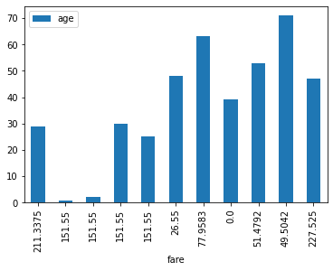
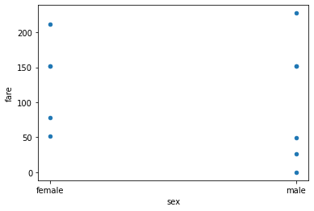
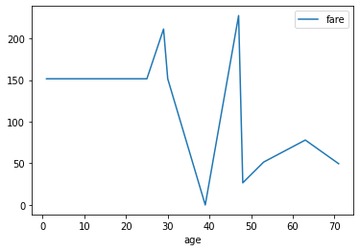
Line, Scatter and Bar Plots with Pandas
Syntax will always be df.plot(kind = ‘bar’/’line’/’scatter’, x = …, y = …)
filt = titanic_df.loc[:10]
filt.plot(kind='bar', x='fare', y='age')
filt.plot(kind='scatter', x='sex', y='fare')
filt=filt.sort_values(by='age')
filt.plot(kind='line', x='age', y='fare')

Slide 41
Practice Problems

Slide 42
Coding Question 1
Write a Python function named genre_titles that extracts titles from a given genre, filters titles containing a specified keyword (case-insensitive), and returns a dictionary where each key is a genre and each value is a list of book titles that match the criteria.
Read the dataframe from the file books.csv and save it into a variable df
Usage example:
>>> genre_titles(df, "Fiction",'great')
{'Fiction': ['The Great Gatsby']}
Finally, save this result into a DataFrame called filtered_books

Slide 43
We made it! Thank you for a wonderful semester!
Please take a minute to fill out course evaluations - they really make a difference.
As well, Reflection 13 will have a few questions about your course experience.

